Slide 1
Capstone Project
Seoul Bike Sharing Demand Prediction
Suvendu Nayak
Cohort Geneva

Slide 2
Key Steps:
Defining the problem statement
EDA and data visualization
Data preprocessing
Feature selection
Preparing Dataset for model
Applying model
Model validation and selection

Slide 3
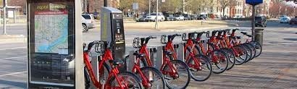
Problem Statement:
Currently Rental bikes are introduced in many urban cities for the enhancement of mobility comfort. It is important to make the rental bike available and accessible to the public at the right time as it lessens the waiting time. Eventually, providing the city with a stable supply of rental bikes becomes a major concern. The crucial part is the prediction of bike count required at each hour for the stable supply of rental bikes.

Slide 4
Why is predictive analytics useful for bike sharing company ?
Bike availability every time and everywhere and avoiding over-capacities.
Bike position : how and when.
Reduction of bottlenecks caused by regular bike maintenance.
High availability of bikes increase the customer satisfaction.

Slide 5
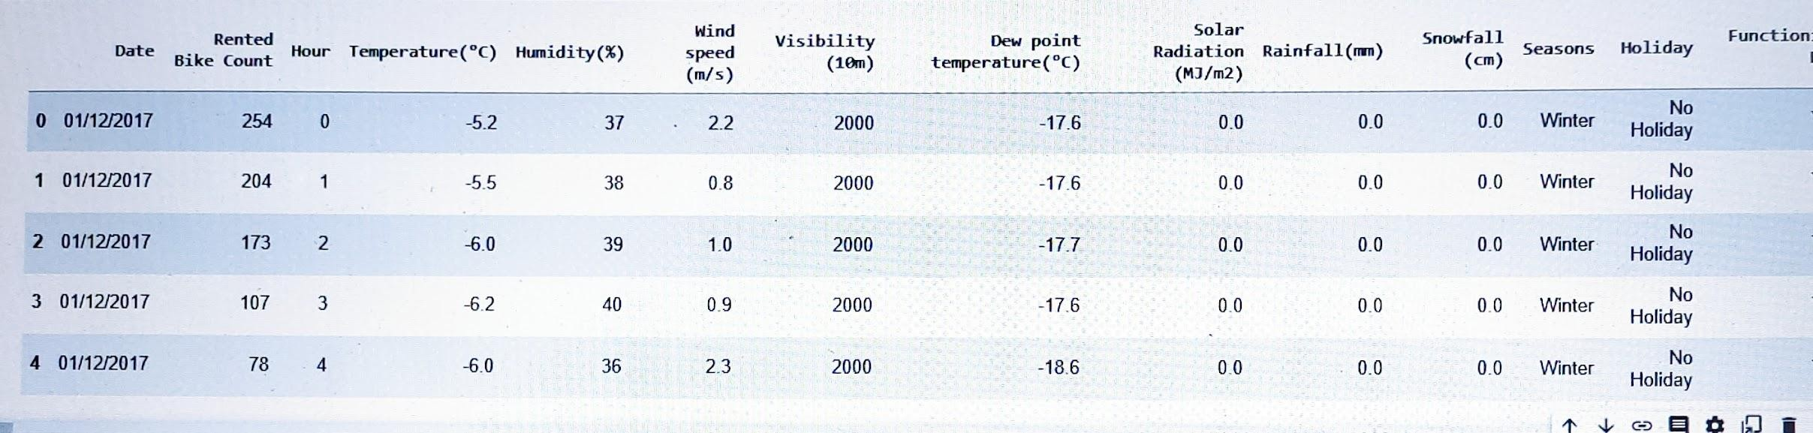
Dataset:
Rows: 8760
Columns: 14

Slide 6
Variable Names:
Date : year-month-day
Rented Bike count - Count of bikes rented at each hour
Hour - Hour of the day
Temperature-Temperature in Celsius
Humidity - %
Windspeed - m/s
Visibility - 10m
Dew point temperature - Celsius
Solar radiation - MJ/m2
Rainfall - mm
Snowfall - cm
Seasons - Winter, Spring, Summer, Autumn
Holiday - Holiday/No holiday
Functional Day - NoFunc(Non Functional Hours), Fun(Functional hours)

Slide 7

Exploratory Data Analysis:
EDA is used for analyzing what the data can tell us before the modeling or by applying any set of instructions/code.
Exploratory Data Analysis refers to the critical process of performing initial investigations on data so as to discover patterns, to spot anomalies, to test hypotheses and to check assumptions with the help of summary statistics and graphical representations.

Slide 8
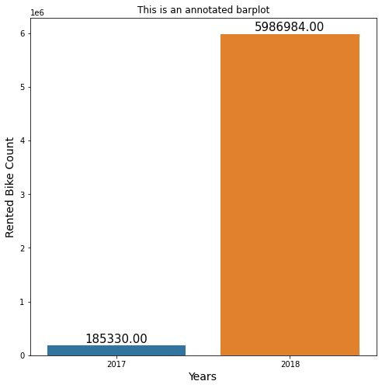
Rented Bike Count Per Year:
We can see in year 2018 the rented bike count was 5986984 which is greater than 2017.

Slide 9
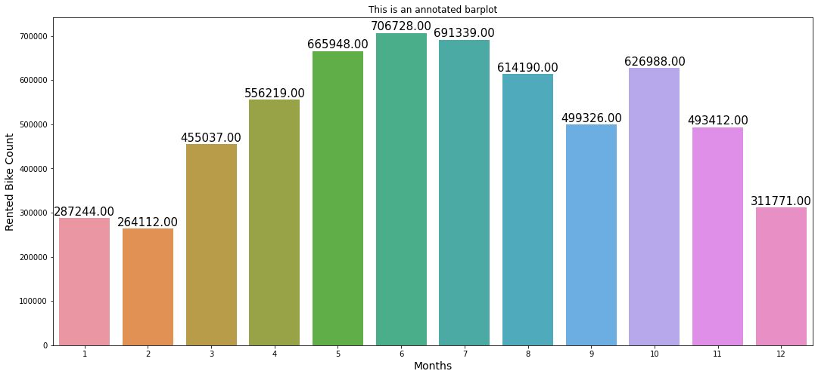
Rented Bike Count Per Month:
We can see in 6th month or in june the rented bike count is 706728 which is highest and in 2nd month or in feb the count was lowest which is 264112.

Slide 10
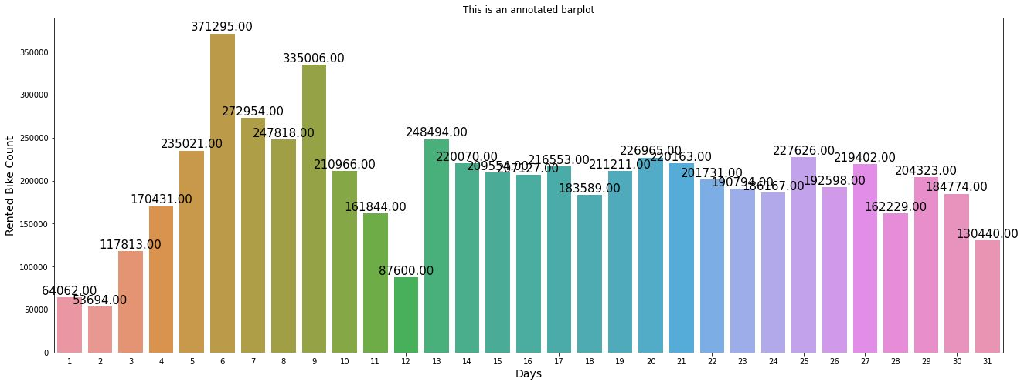
Rented Bike Count Per Day:
We can see the rented bike count is highest on 6th day of the month which is 371295 and lowest on 2nd day of the month which is 53694.

Slide 11
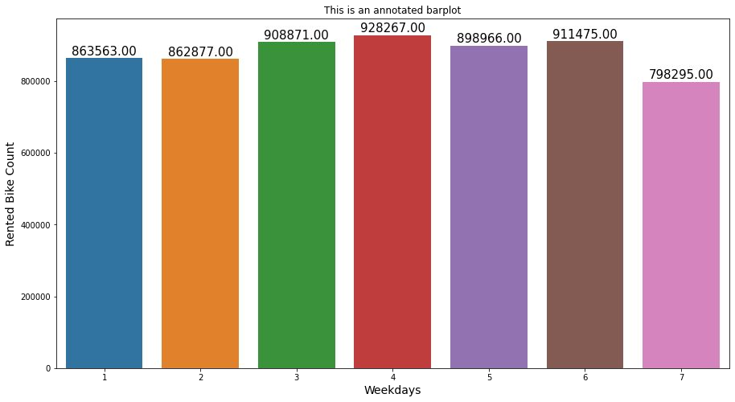
Rented Bike Count In Weekdays:
We can see on 4th day of week the rented bike count is 928267 which is highest.

Slide 12
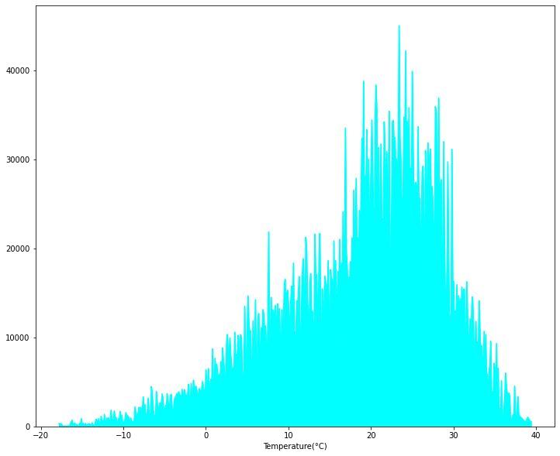
Rented Bike Count With Respect To Temperature:
People prefer to take bike ride more often when the temperature is near about 25 degrees Celsius. we can easily conclude that the people gave more preference to bike riding in summers as compared to other seasons.

Slide 13
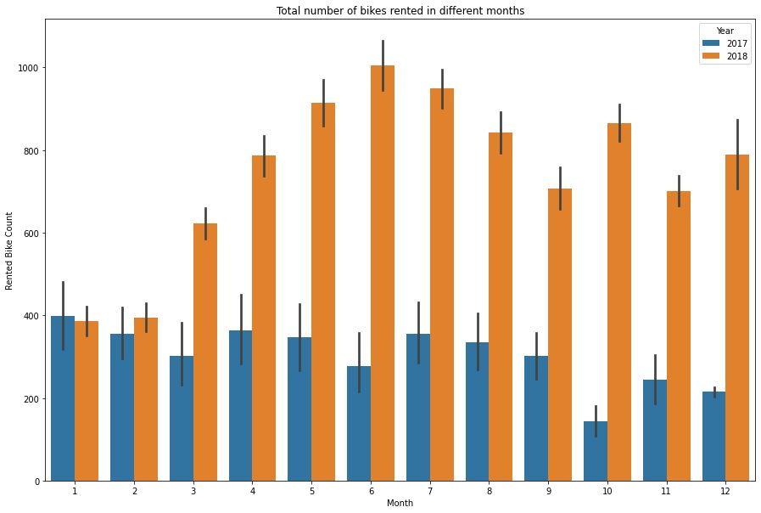
Rented Bike Count In Month:
There's is a whooping increase in number of bike rents in year 2018. In the last month the demand decreases in 2018 but increases in it seen to be increasing in the end of 2017. It is like this because, in 2017 the demand is taking off and we can see the pattern as it is still increasing in the beginning months of 2018. There is a decline in the end of the year. This could be repercussions of winter season as well.

Slide 14
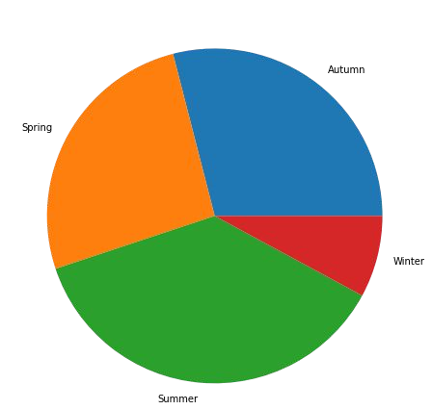
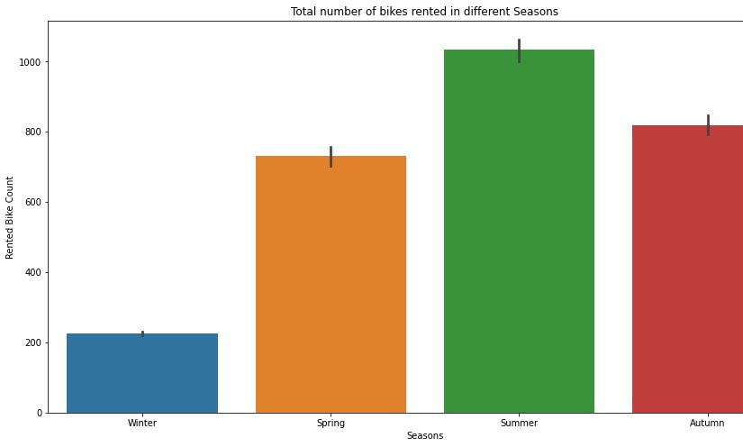
Rented Bike Count In Different Seasons:
With pie and bar plot we can say in summer the rented bike count was high as compared to other seasons and lowest in winter season.This is because when temperature decreases amount of snowfall increases due to which people avoid getting out that is the reason in summer rented bike count increases.

Slide 15

Rented Bike Count On Holiday and On No Holiday:
We can say on no holiday the rented bike count is much more high than on holiday.

Slide 16
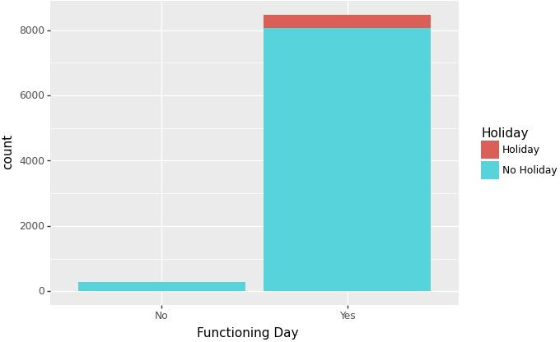
Rented Bike Count On Functioning Day:
An ironic insight, all the holidays are falling on the functioning Days.

Slide 17
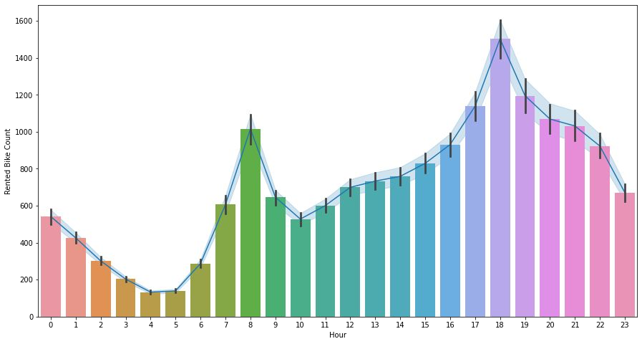
Rented Bike Count Per Hour:
With the graph we can say on 18th hour of the day there is a huge spike in the count of rented bike which is approx. 1600.

Slide 18
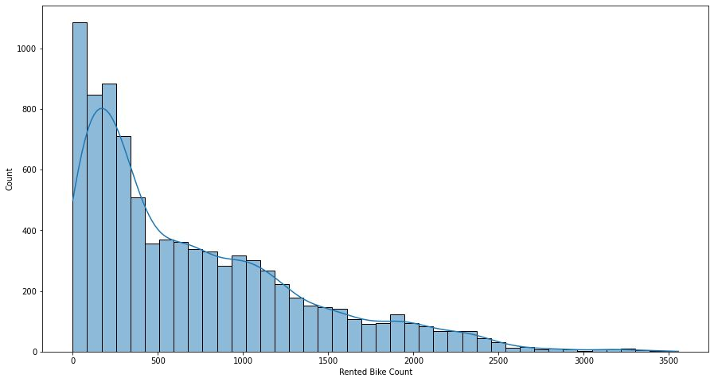
Positively Skewed Data:

Slide 19
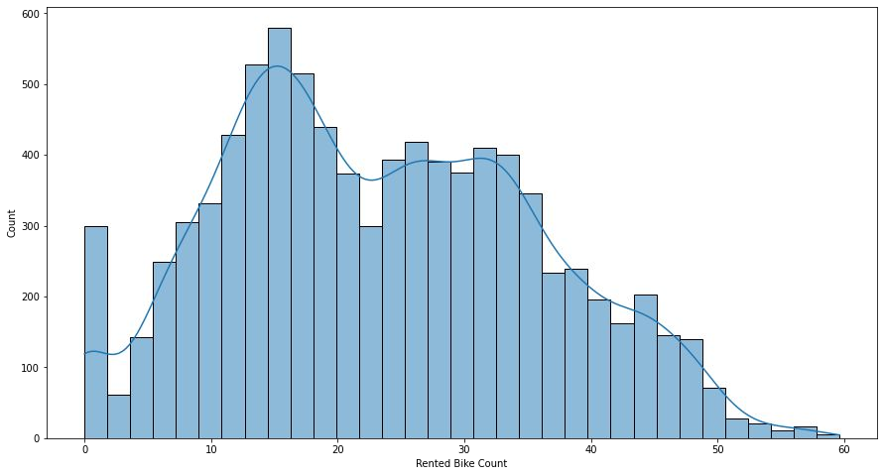
After Square Root Transformation:

Slide 20
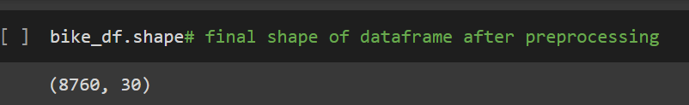
Data Preprocessing:
Data After Converting to Numerical :
Rows: 8760
Columns: 30
Which columns we have converted ?
Seasons
Holiday
Functioning day
Date
Month

Slide 21
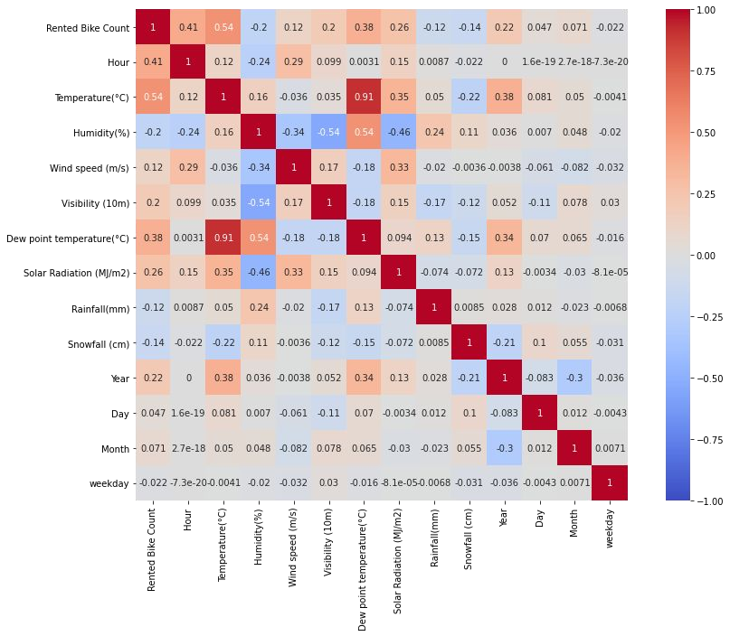
Correlation:
Heat map shows slightly positive relation of Rented bike count with Hour, Temperature, Dew point Temperature, Solar Radiation.
Bike sharing count is negatively co-related to Humidity, Snowfall, Rainfall.
Temperature and Dew point temperature are positively co-related.

Slide 22
Models Used:
Linear Regression
Ridge Regression
Lasso Regression
Decision Tree Regressor
Random Forest
Gradient Boost
XGBoost

Slide 23
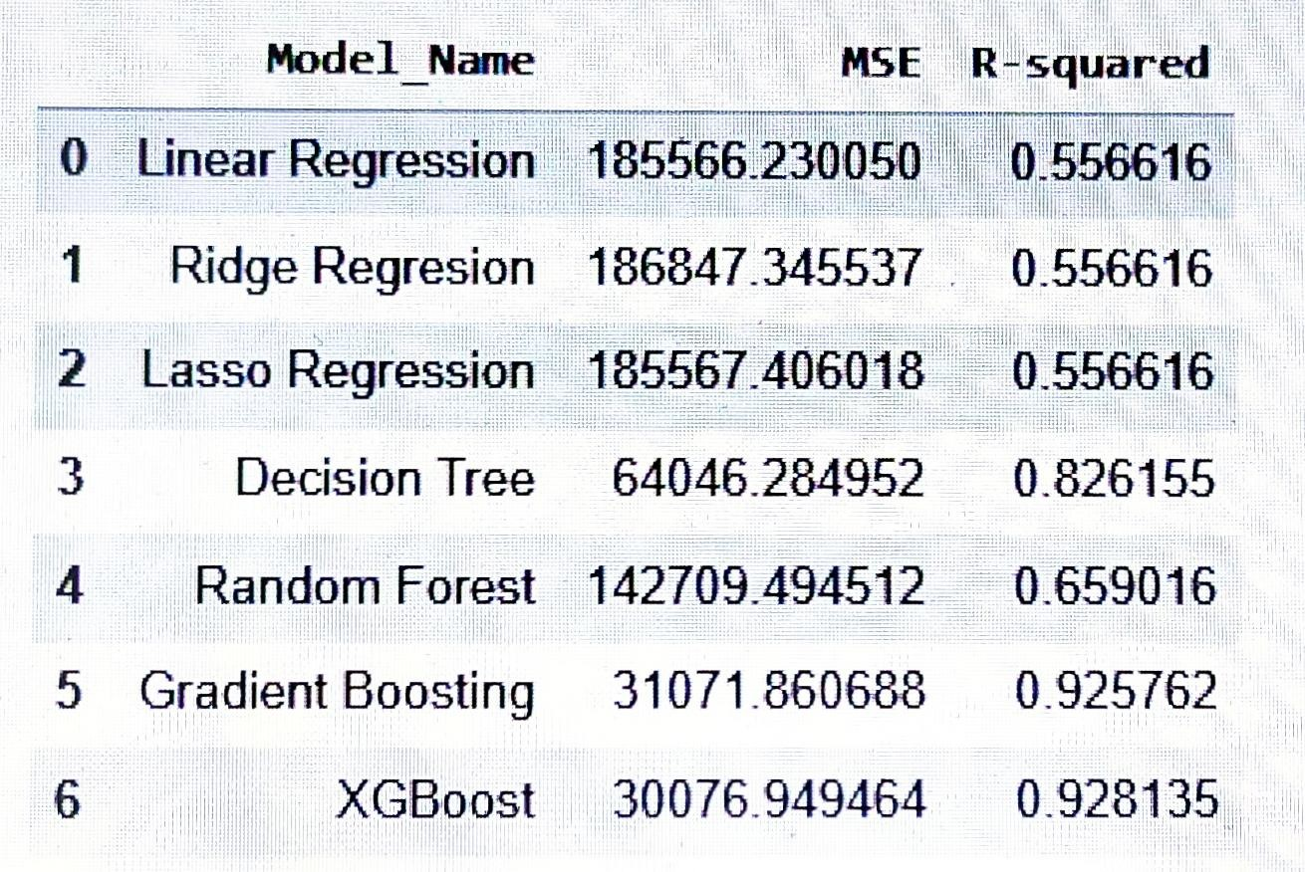
Evaluation Metrics:

Slide 24
Model Validation and Selection:
Observation 1:
With lasso training score came to be 0.56 and test score came to be 0.55.
Number of features used are 26.
Training score for alpha=0.01 came to be 0.56 and test score for alpha =0.01 came to be 0.55.
Number of features used: for alpha =0.01 is 28.
Training score for alpha=0.0001 came out to be 0.56 and test score for alpha =0.0001 came to be 0.55. number of features used: for alpha =0.0001 is 28.
As Linear Regression is not giving us great result, we tried doing regularization we’ve used Ridge and Lasso Regression but still we did not reached to that extent.
Observation 2:
Then we tried using tree based models, we’ve used Decision tree regressor and Random Forest still we did not got good scores.

Slide 25
Model Validation and Selection:
With Decision tree we reached at the model r squared value of 0.84. We only ﬁtted with minimum number of leaf hyperparameter. With default parameters it overﬁtted and reached r-squared at 1 with train dataset but 0.83 with test.
With random forest our r2 score came out to be 0.67 on training set and 0.64 on test set.
Observation 3:
Gradient Boosting and XG Boost came for rescue this models have performed equally good in terms of R-squared and Root Mean Squared Error as this are ensemble models.
Gradient boost came for the rescue to help us get best accuracy to approximate numbers of rented bikes demand.
By increasing the number of trees we could overﬁt it to 1 r squared accuracy. But it was plausible results of training r-square at 0.97 and test r-square value at 92 also with adjusted r-square with 0.92.

Slide 26
Model Validation and Selection:
The test accuracy of Gradient Boosting and XG Boost is almost the same. We can choose any model for the Bike Sharing Demand Prediction. But, XGBoost has some added advantages over Gradient Boosting like regularization.
If we choose Gradient Boosting for our model then the best hyperparameters are:
'max_depth': 10,
'min_samples_leaf': 40,
'min_samples_split': 50,
'n_estimators': 200

Slide 27
Model Validation and Selection:
If we choose the XGBoost instead of Gradient Boosting, then best hyperparameters for the algorithm are:
'colsample_bytree': 0.7
'learning_rate': 0.05
'max_depth': 7
'min_child_weight': 4
'n_estimators': 500
'nthread': 4 'objective': 'reg:linear' 'silent': 1
'subsample': 0.7

Slide 28
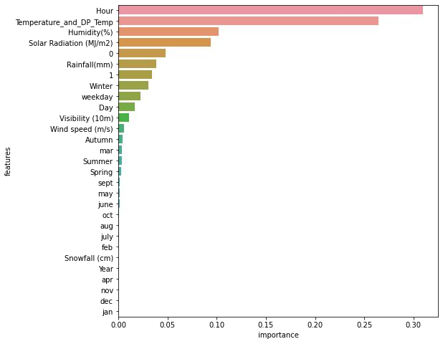
Feature Importance for Gradient Boost:
Feature (variable) importance indicates how much each feature contributes to the model prediction. Basically, it determines the degree of usefulness of a specific variable for a current model and prediction

Slide 29
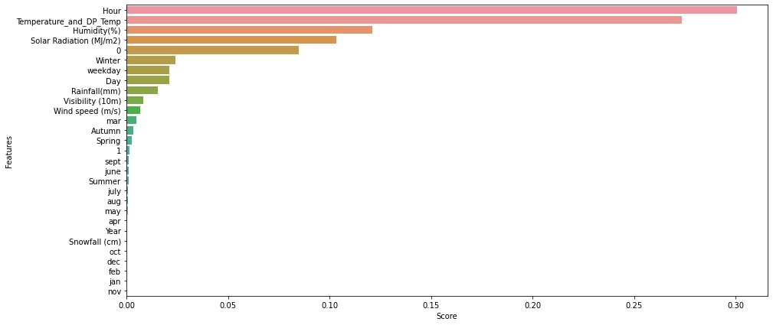
Feature Importance for XGBoost:

Slide 30
Challenges:
~ Execution Takes Time
~ As there was no Linearity between independent and Dependent variable our linear regression model did not performed well.
~ There was Multicollinearity available between variables.

Slide 31
Conclusion:
As it was stated in the problem statement, the business just started out in 2017. So the number of bikes rented in 2017 were too small.
The rise in demand started from the end of 2017 that too in the winter season of the year. The observer may ﬁnd it weird because demand decreased in the end of 2018. Actually for this situation it can be said that, as the business grew to april 2018 it had increased exponentially as compared to 2017. So, we can say that in winter 2017 demand increased but it wasn't still upto the mark of it's full potential. With simple heuristics for future as well if everything else in independent variables remains constant we can say that, the demand will decrease in december but with the proportionate to the overall demand of that year.
The number of business hours of the day and the demand for rented bikes were most correlated. It's common sense too.
Highest number of bike rented at the 18th hour of day.
After trying combinations of features with linear regression the model underﬁtted. It seemed obvious because data is spread too much. It didn't seem practical to ﬁt a line.

Slide 32
Conclusion:
The Feature_importance was almost the same in both the tree based models. Gradient boost ﬁne-tunes with error of the prior trees this is why it gets better accuracies.
HOUR and TEMPERATURE_AND_DP_TEMPERATURE column are the main columns helping in prediction.
With XGBoost Regressor we can see the r2 score on training data came to be 0.99 and on test data it is 0.92 which is quite good.

Slide 33


